Slide 1
AgriAI: Empowering Farmers with Predictive Crop Analysis
and Disease Management
Welcome to our final project presentation on sustainable agriculture. In this introduction, we'll provide an overview of our research and proposed solutions to improve farming practices and food security.
by Darshan Bilasanur Reddy
& Sandeep Narindi
Supervised by:
Dr. Xing Tan
1

Slide 2
Outline
Problem statement ----------------------------------------------------------------- 3
Research Objective ----------------------------------------------------------------- 4
Systematic Review Methodology ---------------------------------------------------- 5
Research Question ----------------------------------------------------------------- 6
Insights from Survey Results -------------------------------------------------------- 7-10
Crop Prediction Model and dataset -------------------------------------------------- 11-16
Disease prediction Model and dataset ----------------------------------------------- 17-21
Website --------------------------------------------------------------------------- 22-23
Conclusion ------------------------------------------------------------------------ 21
2

Slide 3

Problem statement
The agriculture industry faces challenges in accurately predicting crop yields and identifying crop diseases early, which can lead to significant economic losses for farmers.
Existing solutions are often complex, costly, and not accessible to small-scale farmers, limiting their ability to effectively manage their operations.
There is a need for a user-friendly, affordable, and scalable solution that can empower farmers to make informed decisions and improve their overall productivity and profitability.
3

Slide 4
Research Objective
1
Survey Analysis
Conduct a survey analysis of machine learning (ML) and deep learning (DL) algorithms for crop yield prediction and crop disease prediction, utilizing survey responses to guide algorithm selection.
2
Develop Predictive Models
Implement and perform a comparative analysis of machine learning (ML) and deep learning (DL) algorithms for crop yield prediction and crop disease prediction.
3
Deploy Model to a Website
Utilize the findings of the comparative analysis to develop a user-friendly website tailored for farmers, integrating intuitive tools and resources to facilitate informed decision-making and enhance agricultural productivity.
4

Slide 5
Systematic Review Methodology
The Systematic Review Methodology section outlines review protocol, research questions, search strings and exclusion criteria used in this research
Planning Stage:
Identify research questions.
Define search strings and select databases.
Define publication selection protocol.
Execution Stage:
Conduct comprehensive evaluation of ML approaches for crop yield prediction.
Utilize search strings across six databases:
Science Direct, Web of Science, SpringerLink, Wiley, Google Scholar, Scopus.
Extract key information from gathered papers: dataset, algorithms used, evaluation metrics, publication year, and author names.
Reporting Stage:
Document findings and answer research questions.
Follow a review protocol similar to Klompenburg et al. (2020).
5

Slide 6
Research Question
[RQ1.] What data sets have been used in the literature for crop yield prediction?
[RQ2.] Which ML algorithms are used in the literature for crop yield prediction?
[RQ3.] Which evaluation matrix has been used in the ML literature for crop yield prediction?
[RQ4.] Who will be benefited from this crop yield prediction using AI?.
Search Strings and Exclusion criteria
Search strings: 'precision agriculture with ML OR AI’ , 'crop prediction with ML and AI', 'crop yield prediction and ML OR AI', across six databases, with Corpus and Web of Science yielding no results.
Exclusion criteria:
Papers published after 2019
Including only research articles
Publication title not relevant to agricultural sector
Not written in English
Duplicate publications
Relevant to research questions
6

Slide 7
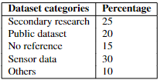
Insights from Survey Results
RQ1. What data sets have been used in the literature for crop yield prediction?
Secondary research was mostly used due to scattered data sources.
16 papers used publicly available datasets.
Some publications described datasets but didn't share them.
Real-time data came from sensors, and some studies combined with existing datasets.
7

Slide 8
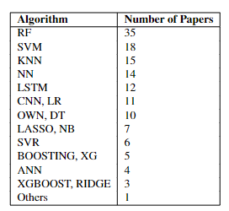
Insights from Survey Results (cont..)
RQ2. Which ML algorithms are used in the literature for crop yield prediction?
Traditional methods like Logistic Regression and Naive Bayes were used for crop disease diagnostics.
Advanced techniques like Decision Trees, Random Forest, K-Nearest Neighbors, and Support Vector Machines were applied for crop recommendation and yield prediction.
Neural networks such as Convolutional Neural Networks and Long Short-Term Memory networks were explored for plant disease detection and weather forecasting.
Ensemble methods like Boosting and Extreme Gradient Boosting improved predictive performance.
Regularization techniques like LASSO and Ridge Regression enhanced model interpretability, especially in agricultural yield prediction and soil nutrient estimation.
8

Slide 9
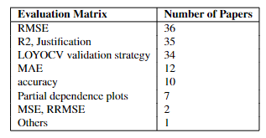
Insights from Survey Results (cont..)
RQ3. Which evaluation matrix has been used in the ML literature for crop yield prediction?
Evaluation metrics used: RMSE, R2, LOYOCV, MAE, and accuracy.
Most frequent metrics: RMSE, R2, LOYOCV.
Insights provided: Accuracy, goodness of fit, generalization capability.
Importance in agriculture: Crucial for dealing with time-series data.
Additional techniques used: MSE, RRMSE, partial dependence plots.
Diverse set of evaluation methods applied across various algorithms.
Aim: Comprehensive assessment of predictive models in agricultural contexts.
9

Slide 10
Insights from Survey Results (cont..)
RQ4. Who will be benefited from this crop yield prediction using AI?
Crop prediction models multifaceted role in enhancing productivity, sustainability, and risk management within the agricultural industry, benefiting farmers, cooperatives, agricultural agencies, and insurance companies, policy makers, stake holders and consumers.
Farmers: Make informed decisions for higher productivity
Cooperatives, Agencies, and Organizations in Agriculture: Leading Sustainable Farming Methods
Organizations: Crop and soil monitoring in real time for better management
Insurance Companies: Crop Insurance and Risk Assessment Offering
Policy Makers and Stake holders
Consumers: Maintaining Stable Food Supplies and High-Quality Produce
10

Slide 11
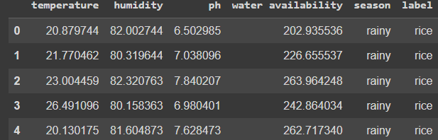
Crop Prediction Model and dataset
Comprehensive Analysis Of Machine Learning Algorithms
Selected Algorithms:
Decision Trees (DT)
Random Forests (RF)
Logistic Regression (LR)
K-Nearest Neighbors (KNN)
Support Vector Machines (SVM)
11

Slide 12



Why this Dataset?
Not site specific
Robust Dataset
Predictive Insights for Risk Mitigation
The dataset comprises the following columns:
Temperature: The average temperature in degrees Celsius, indicating the climatic conditions in the region.
Humidity: The relative humidity level expressed as a percentage, reflecting the amount of moisture in the air.
pH: The pH value of the soil, representing its acidity or alkalinity.
Water Availability: A measure of soil moisture or water availability, indicating the amount of water accessible to plants.
Season: The categorical feature representing the season during which the data was recorded. This provides insights into the annual climate cycle.
Label: The crop label indicating the type of crop cultivated. The dataset includes a variety of crops such as blackgram, chickpea, cotton, jute, kidneybeans, lentil, maize, mothbeans, mungbean, muskmelon, pigeonpeas, rice, and watermelon
12

Slide 13
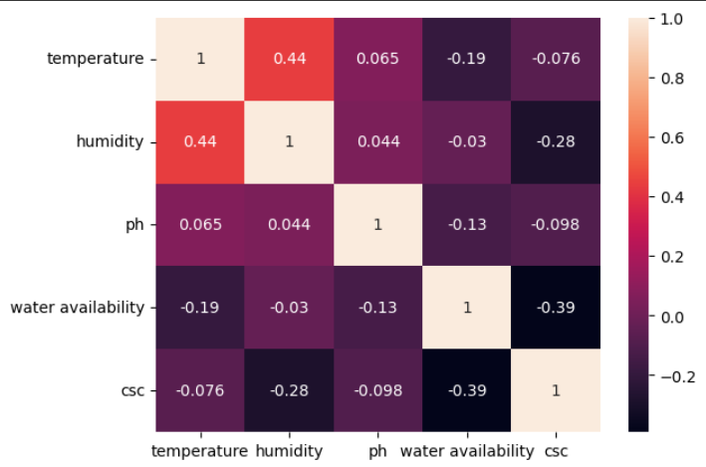
Data Analysis
Data Integrity: The dataset is complete with no missing values, ensuring reliability.
Dataset Imbalance: Maize records significantly outnumber other crops. Implemented SMOTE to balance the dataset and enhance predictive performance.
Season Mapping: Converted the season column from string to integers:
"rainy" - 1
"winter" - 2
"summer" - 3
"spring" - 4
13

Slide 14
Metric Evaluation of Algorithms
The metric evaluation of all the algorithms are mentioned below
Decision Tree Avg Precision: 0.949
Avg Recall: 0.9503
Avg F1 score: 0.9417
Random Forest
Avg Precision: 0.9897
Avg Recall: 0.9881
Avg F1 score: 0.9884
Logistic Regression
Avg Precision: 0.8607
Avg Recall: 0.8663
Avg F1 score: 0.8595
SVM
Avg Precision: 0.9728
Avg Recall: 0.9655
Avg F1 score: 0.9686
KNN
Avg Precision: 0.9828
Avg Recall: 0.9555
Avg F1 score: 0.9486
14

Slide 15
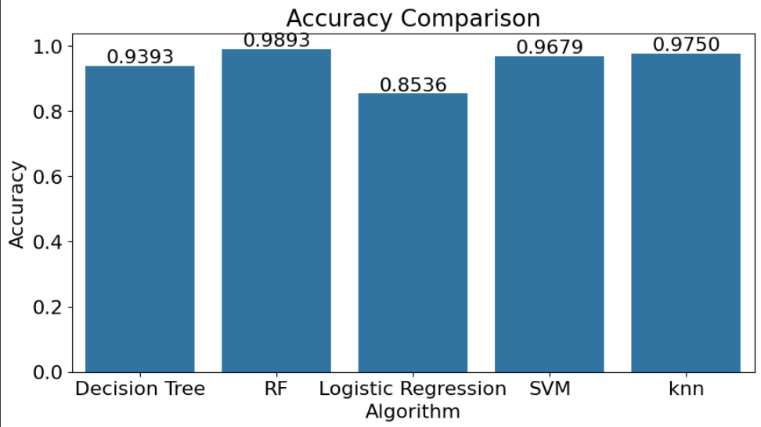
Accuracy Comparison
Accuracy comparison of all the algorithms can be seen in the below image
15

Slide 16
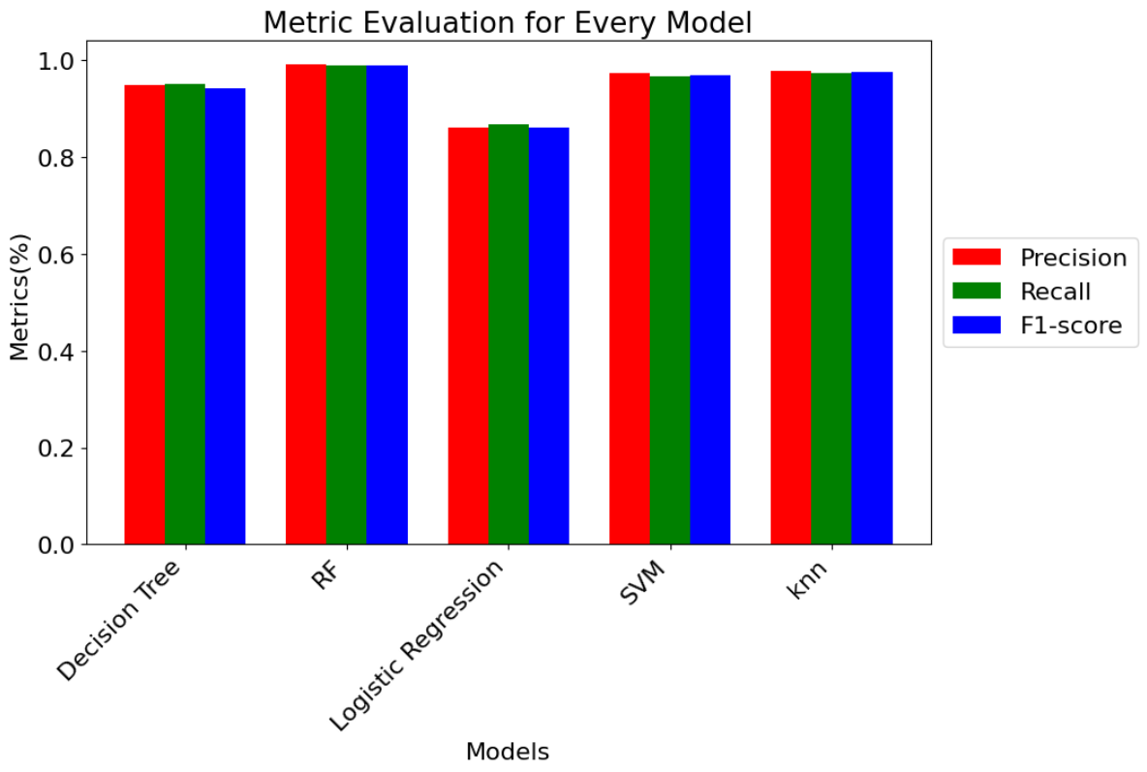
Metric Evaluation Comparison
Metric evaluation of all the algorithms can be seen in the below image
16

Slide 17
Disease Prediction Model and dataset
Dataset Source:
Combination of 5 different datasets sourced from Kaggle.
Crop Species and Dataset Origin:
Corn: PlantVillage dataset [1].
Potato: PlantVillage dataset [1].
Rice: Dhan-Shomadhan dataset [2] and "Rice Leafs" dataset from Kaggle [4].
Wheat: "Wheat Disease Detection" dataset from Kaggle [5].
SugarCane: "Sugarcane Disease Dataset" from Kaggle [6].
Selected Algorithm: Convolutional Neural Networks (CNN).
17
Notes:
[1] https://www.kaggle.com/datasets/shubham2703/five-crop-diseases-dataset/data

Slide 18
Dataset Overview
Total Classes: 17
Total Images: 13,324
Corn Plant Species:
Common Rust: 1192 images
Gray Leaf Spot: 513 images
Healthy: 1162 images
Northern Leaf Blight: 985 images
Total Images: 3852 images
Rice Plant Species:
Brown Spot: 613 images
Healthy: 1488 images
Leaf Blast: 977 images
Neck Blast: 1000 images
Total Images: 4078 images
Potato Plant Species:
Early Blight: 1000 images
Healthy: 152 images
Late Blight: 1000 images
Total Images: 2152 images
Wheat Plant Species:
Brown Rust: 902 images
Healthy: 1116 images
Yellow Rust: 924 images
Total Images: 2942 images
SugarCane Plant Species:
Red Rot: 100 images
Healthy: 100 images
Bacterial Blight: 100 images
Total Images: 300 images
18

Slide 19
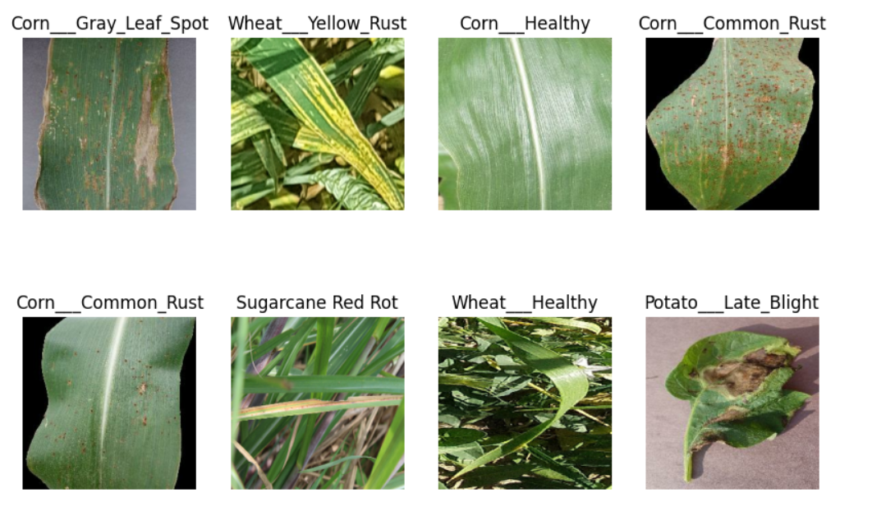
Dataset Images
19

Slide 20
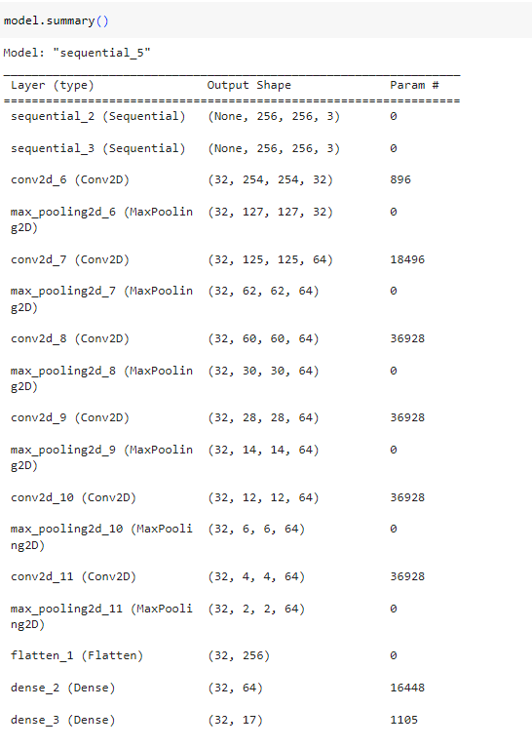
CNN Model
Constraints used: The following constraints has been used for our model.
Image size: 256
Batch size: 32
Channels: 32
Epochs: 10
Data Split
Training: 80%
Testing: 10%
Validation: 10%
20
Notes:
[1] https://www.kaggle.com/datasets/shubham2703/five-crop-diseases-dataset/data

Slide 21
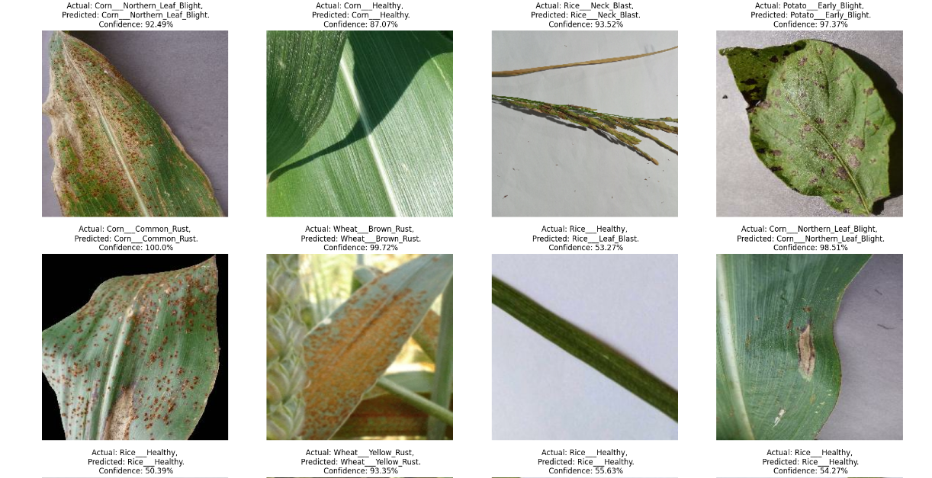
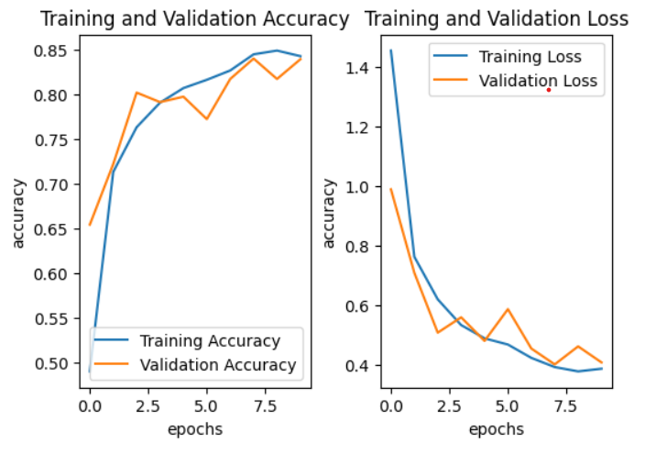
Results of disease prediction
Training and Validation Accuracy and Training and Validation Loss Can be seen Below [1]
21
Notes:
[1] https://www.kaggle.com/datasets/shubham2703/five-crop-diseases-dataset/data

Slide 22
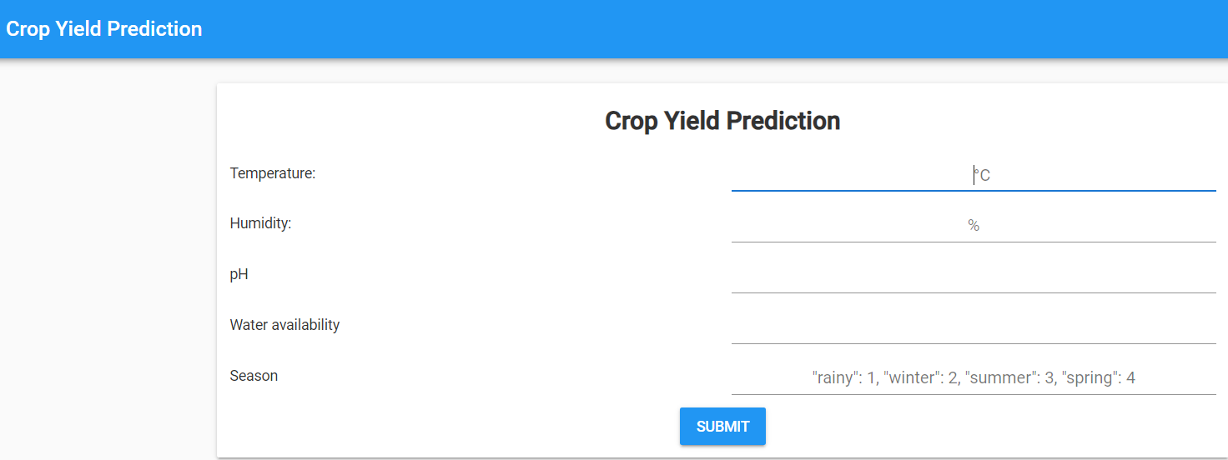
About Website
Our website is a comprehensive platform that provides valuable insights and tools for the agriculture industry. Featuring cutting-edge crop prediction algorithms, it empowers farmers to make informed decisions and optimize their operations.
Designed with a user-friendly interface, the website offers seamless access to a wealth of agricultural data and resources.
This website is developed using anvil.
22
Notes:
https://feisty-memorable-songbird.anvil.app/

Slide 23
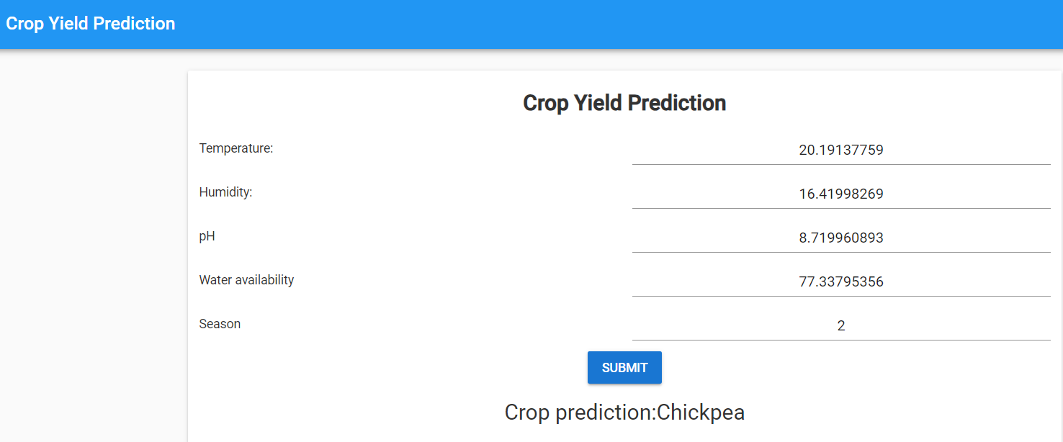
About Website
We have provided the values from the dataset to see if it predicts accurately. As you can see in the below screenshots it predicts accurately.
23

Slide 24
Next Steps and Future Opportunities
Future Opportunities
Room for growth and optimization of solutions.
Integration of real-time data.
Expansion of dataset.
Refinement of models to enhance accuracy and usefulness of the platform.
Next Steps
Refine models
Gather additional data
Collaborate with industry partners
Bring solutions to market
Maximize real-world impact
24

Slide 25
Conclusion and Discussion
Key Takeaways
Valuable insights into agriculture industry through research and algorithms.
Demonstrated potential of predictive modeling for crop yields and disease detection.
Societal Impact
Support for farmers
Improvement of food security
Contribution to sustainable agricultural practices
Continued development and deployment of technologies for positive change
25

